Slide 1
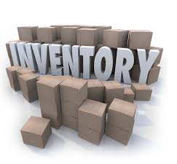

IS 436 Deliverable 2: Retail Inventory System
Leader Justin Chan
QA Parmeet Dua
Programmer Brandon Nguyen
Analyst Urgy Eado
QA Support Jaime Pineda
Project Manager Rafay Khurram
Editor Raj Desai

Slide 2
1) Requirements Definition Document

Slide 3

Process – Oriented Functional Requirements
The system must allow employees to insert and delete items The system must check orders for inventory availability.
The system must allow employees to sort items into sub categories.

Slide 4
Information – oriented functional requirements:
The system must update the inventory count of numerous items in real time.
The system must keep track of inventory at all company locations and warehouses.
The system should keep track of all company employees.
The system should update and compare the prices of items in real time.
The system should automatically update based on order cycles set by employees.
The system should protect against stock-outs.

Slide 5
Nonfunctional requirements
Operational:
The system should be compatible with any web browser.
The system should be accessible on mobile devices.
Performance:
The system should be accessible 24 hours a day and 365 days a year by company employees.
Interactions such as adding items should be quick and seamless.
Security:
All company employees have complete access to the system.
The system includes all available safeguards from security attacks.

Slide 6
1A) Interview Information

Slide 7
Jason Zimmerman – Software Dev.
Interview Date: 3/9/18 - Rafay
1) What do you want the software to be capable of?
2) What would you want to be compatible with the Inventory Management System?
3) How should stock-outs be handled?
Summary: The system should be able to track and update store information in real time. There should be a clear and distinct method to input and retrieve data.

Slide 8
Joseph Marquez – Store Manager
Interview Date: 3/7/18 - Rafay
1) Where would the IMS be accessed?
2) How automated would you want the system to be?
3) How long should it be accessible?
Summary: All users should have a simple method of access, 24/7. A user friendly interface will assure that all employees are capable of utilizing the system to its full capabilities.

Slide 9
Matthew Connors – Sales Representative
Interview Date: 3/5/18 - Rafay
1) How would you want the system to keep track of your inventory?
2) How many subcategories do you expect you will need for your inventory
3) What format would more visually appealing?
Summary: Inclusion of subcategories will make it more efficient for users to locate specific inventory. A clear formatting will allow for users to navigate through the system with ease.

Slide 10
1B) Observation notes from As-If System

Slide 11
Current Practices
Working with Excel to calculate sale and inventory
POS System used to enter price and check out with a credit card machine or cash drawer
Inventory Workbook is reviewed to determine product reordering
Small businesses utilize the eye test to determine inventory restock

Slide 12
Advantages of As-If System
Simplicity:
Small businesses find manually tracking inventory (Excel, Sheet & Paper) easier due to lack of technological complexity
Cut down cost of purchasing and maintenance of system
Sense of control:
Having a tracking system run manually gives business owners, rather than a computer, a greater sense of control over their business

Slide 13
Disadvantages of Current System
Additional labor: Employees take on the tasks of a computer, such as daily log tracking
Human error: Continuous errors in inventory could cause unnecessary expenses and significant costs
Profit lost: An inventory system would allow for businesses to maximize potential profits through tracking finances, products, and inventory.

Slide 14

1C) Questionnaires
Distributed 3/8/18 || Response Rate: 15 minutes
Do you currently use a manual inventory system?
Do you currently have over 20 employees?
Do you have over 20 unique products?
On a scale of 1-5, how important is a user friendly interface?
How did you hear about us?

Slide 15
1D) Documents used for document analysis

Slide 16
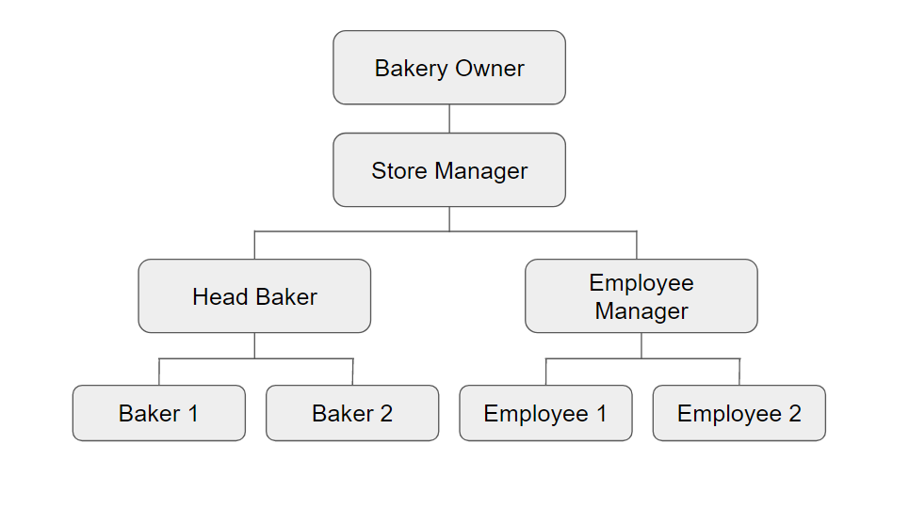
Organizational Chart
When creating a system, we need to keep in mind who will be using our product. By analyzing an existing company’s organization chart, we are able to observe which employee’s/staff will be using our system and provide appropriate training. Additionally, this org chart will aid us in creating a use-case diagram.

Slide 17
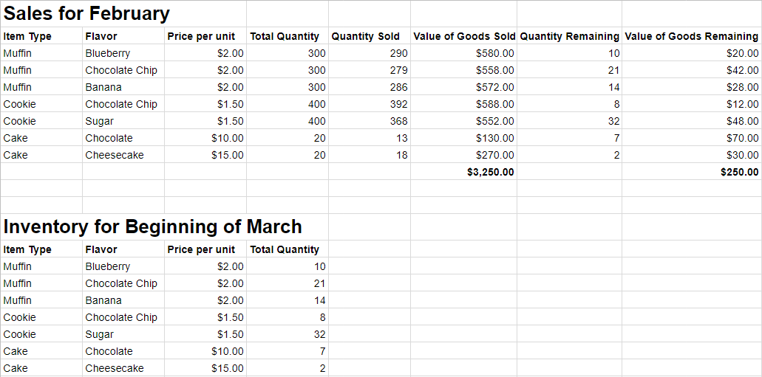
Existing Inventory System
When implementing a new system, it helps to analyze any pre-existing system. We are able to determine which features are useful and if any are expendable. We also need to know which data is important when transferring data over from any legacy systems.

Slide 18
2) Use Case Analysis
Suppliers
List all suppliers
List individual supplier and stock they provide
Add supplier
Remove supplier
Analysis
View daily/weekly/monthly/yearly sales of select product in tables / line graph
View daily/weekly/monthly/yearly projection of sales in line graph
View daily/weekly/monthly/yearly purchase of materials in line graph / tables
View daily/weekly/monthly/yearly projection of materials needed in line graph / tables
Input/change user defined projection algorithms

Slide 19
Inventory
View inventory (incoming, on hand, and in the process of shipping, by category)
Update count of inventory at hand manually
update count of inventory automatically - when things are purchased, returned, or ordered
View attributes of item (item name, description, image, price, condition: damaged, parts missing, perfect condition, minor)

Slide 20
Name | List of all suppliers | View Supplier and their stock | Add/Remove Supplier | View Inventory | Update Inventory (Manual) | Update Inventory (Auto) | View Item Attributes
Number | S1 | S2 | S3 | I1 | I2 | I2 | I3
Description | The user will be able to view all of the suppliers | List individual suppliers and stock they provide | A supplier will be added or removed | A visual of all the inventory and details of specific items are displayed. Details reveal if the inventory is incoming, on hand, or in the process of shipping | Allows the user to set the count of specific inventory items | Inventory items are added and subtracted automatically | Displays inventory attributes such as item name, description, image, price and condition (damaged, parts missing, perfect condition)
Priority | High | High | High | High | High | High | Medium
Actor | inventory manager | Inventory Manager | Inventory Manager | Inventory Manager | Inventory Manager | Inventory Manager | Inventory Manager
Trigger | User hovers over the suppliers tab and clicks on “View All” | User clicks on a supplier in the list of suppliers. | User hovers over the supplier tab, clicks on Add/Remove supplier button, then chooses a supplier to add or remove. | User hovers over the inventory tab and clicks “View All” | User hovers over inventory tab and clicks “Update inventory.” They are then able to set values to specific items. | Inventory is purchased, returned, or ordered | While viewing all the inventory items, the user clicks on one
External or internal | internal | Internal | Internal | Internal | Internal | Internal | Internal

Slide 21
Name | Input/Update Algorithms | Supplies Needed Projection | Supplies Purchase History | View projection of sales in line graph | View sales of select product in tables / line graph | Change Inventory Item attribute | Add new / delete item
Number | A5 | A1 | V7 | P3 | Y7 | S18 | R3
Description | Allows the user to input a user defined algorithm for the projection or sales or materials | Displays daily/weekly/monthly/yearly projection of supplies needed in the form of either a line graph or a table | Displays daily/weekly/monthly/yearly purchase of supplies in the form of either a line graph or a table | Keep track of items projection | Keep track of items depending how often each items need to get checked | User will be able to change item name, description, image, price, and condition (damaged, parts missing, perfect condition, minor) | Add new inventory or delete an inventory item
Priority | Low | Low | High | High | High | High | High
Actor | Inventory Manager | Inventory Manager | Inventory Manager | Inventory manager | Inventory manager | inventory manager | Inventory manager
Trigger | User hovers over the analysis tab and selects either the “Import algorithm” or “Update algorithm” | User hovers over the analysis tab, selects “Supplies Projection” and selects the time frame they desire | User hovers over analysis tab, selects “Supplies Purchase History” and selects the period of time | right click on products, select projection in graphs | Click on products, choose tables or graph for view | While in the viewing inventory items, user selects in edit button | User hovers over the inventory tab and selects either “Add inventory” or “Delete inventory” button.
External or internal | Internal | Internal | internal | internal | internal | internal | internal

